Slide 1

Future Faces of Physics Jeopardy!
Final Jeopardy!

Slide 2
Category-
The Big Screen.

Slide 3
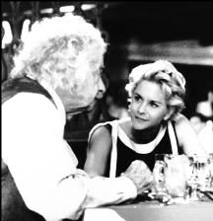
In this 1994 romantic comedy, an auto mechanic chasing Einstein’s intelligent niece pretends to have invented a fusion-powered spacecraft.

